Slide 1
AI Data Analyst
Empowering Data-Driven Decisions through Natural Language Processing

Slide 2




Traditional Data Analysis Faces Significant Technical Barriers
SQL Expertise Gap: Business users often lack the technical skills to query complex databases directly.
Operational Bottlenecks: High dependency on data teams leads to significant delays in decision-making.
Manual Errors: Hand-written queries are prone to syntax errors and schema misunderstandings.
The Missing Link: A critical need exists for a bridge between human language and structured data.

Slide 3

Seamless Natural Language
to SQL Conversion
Intent Interpretation
Context Awareness
Leverages advanced Large Language Models (LLMs) to accurately interpret user intent from natural language questions.
Automates the extraction of database schemas to provide the LLM with the necessary context for precise query generation.
Security First
Local Deployment
Ensures data integrity by strictly executing only read-only SELECT queries, preventing unauthorized modifications.
Designed for local execution, ensuring maximum data privacy, zero latency, and complete control over the environment.

Slide 4




Built on Robust and Modern
Open-Source Technologies
Python 3.11+
LangChain & SQLAlchemy
The core foundation for high-performance data processing, offering extensive library support and seamless integration capabilities.
Providing the essential framework for LLM orchestration and standardized database interaction across various SQL dialects.
Ollama & DeepSeek-R1
Streamlit
Utilizing state-of-the-art local LLMs to ensure precise SQL generation while maintaining complete data sovereignty.
A sleek, interactive frontend that delivers a professional user experience with minimal development overhead.

Slide 5
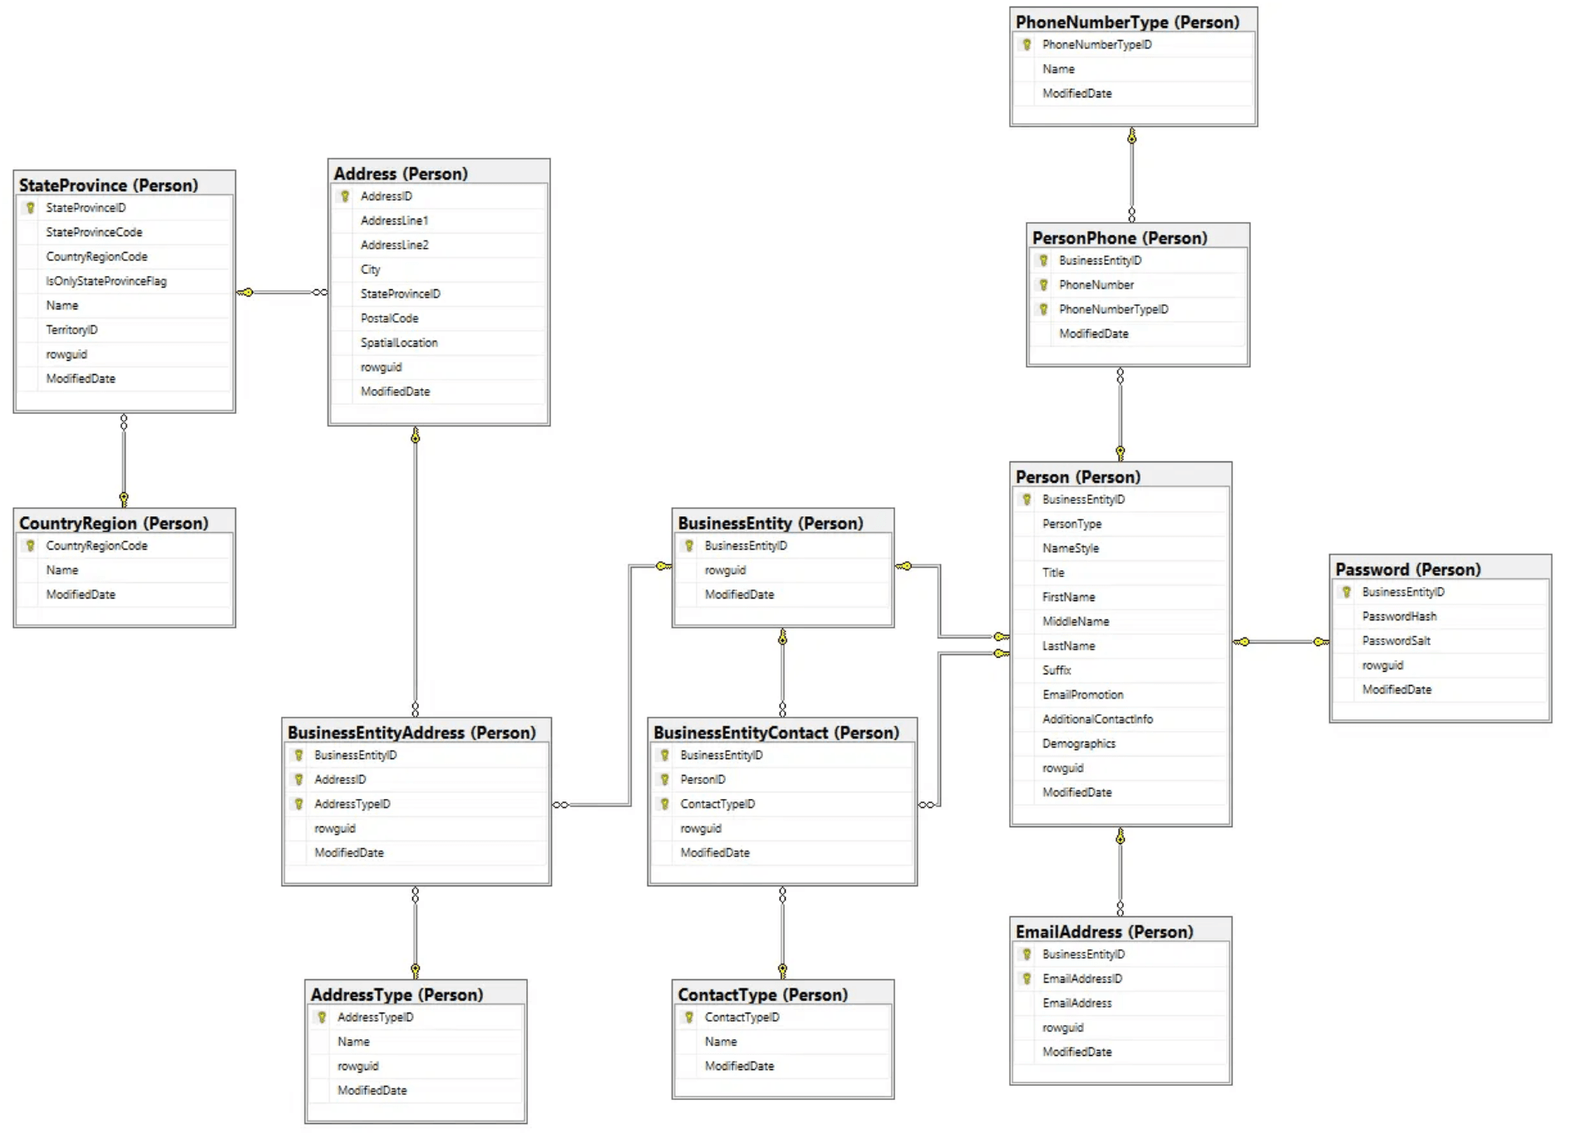
A Streamlined Four-Step Process
from Question to Answer
STEP 01
STEP 02
STEP 03
STEP 04
Schema Extraction
Prompt Engineering
LLM Processing
Execution & Display
Automatically inspects the SQLite database to map tables and columns for context.
Combines the extracted schema with the user's question into a structured prompt.
The DeepSeek model generates a valid SQL query based on the provided context.
The query runs against the database, and results are presented in the Streamlit UI.

Slide 6
Precision-Engineered Prompts for Accurate Querying
01 / SYSTEM ROLE
02 / CONSTRAINTS
Expert SQL Generator
Strict Syntax Rules
System prompts explicitly define the LLM as an Expert SQL Generator, ensuring the model prioritizes technical accuracy and schema adherence.
Rigid constraints prevent the model from including preambles, explanations, or unsupported SQL features, resulting in clean, executable code.
03 / POST-PROCESSING
04 / OPTIMIZATION
Automated Cleanup
Zero Temperature
Advanced regex-based processing removes "Think" tags and non-SQL artifacts, sanitizing the LLM response for direct database execution.
Model temperature is locked at 0.0 to eliminate randomness, ensuring maximum consistency and reproducibility for every data query.

Slide 7
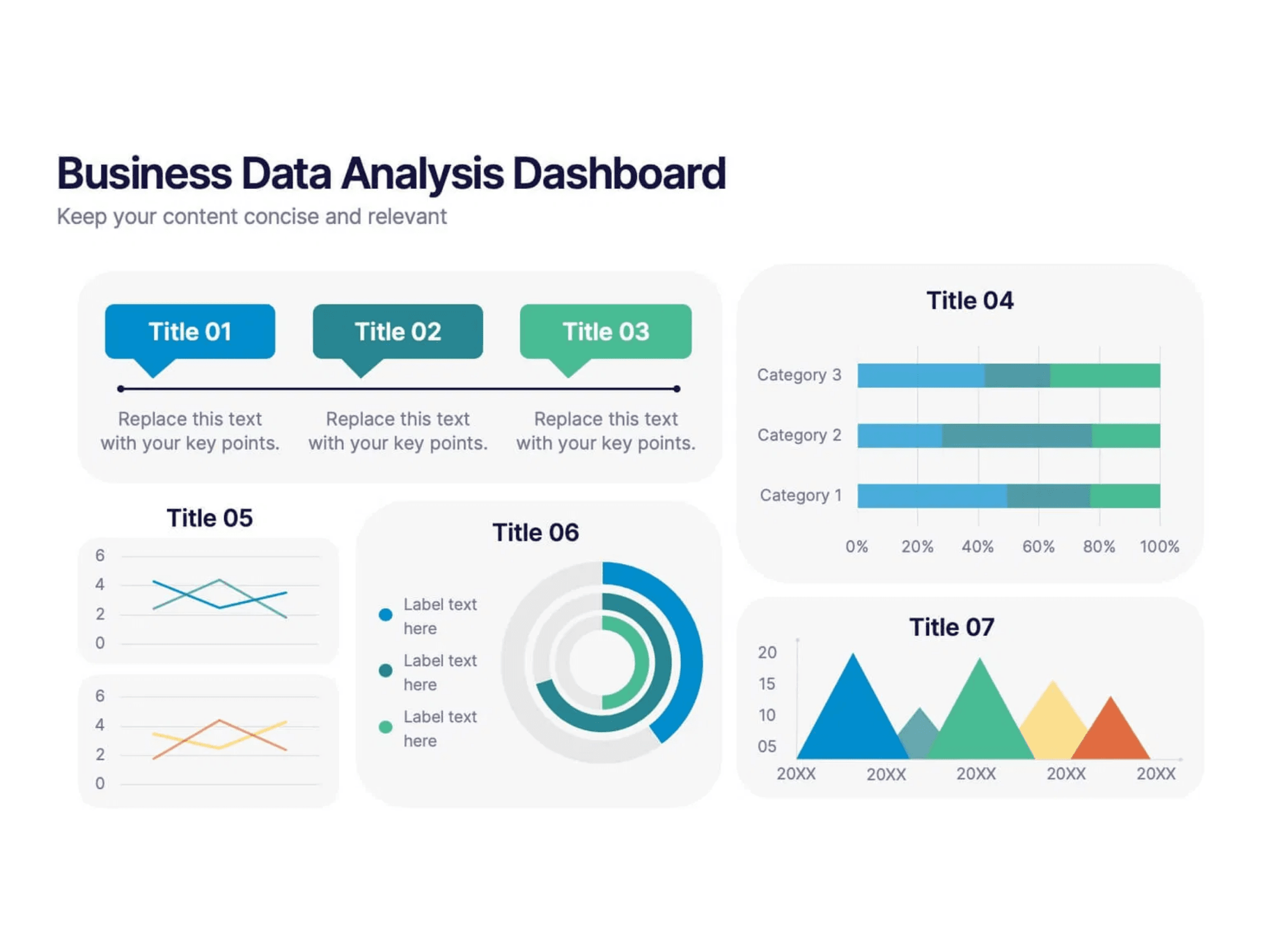
Empowering Users with a Simple and Intuitive Frontend
Natural Language Input
Streamlit-based interface allows users to type questions as if they were talking to a colleague, removing technical friction.
Real-Time Feedback
Interactive elements like spinners and success notifications keep users engaged and informed during the analysis process.
Clear Data Presentation
Results are formatted with high legibility, making complex database outputs easy to digest and act upon instantly.

Slide 8
Prioritizing Enterprise-Grade
Security in Local Environments
01
02
Local Execution
Read-Only Access
All data processing and LLM inference occur on-premise. No sensitive data ever leaves your local network, eliminating external exposure risks.
The system is architected to execute only SELECT queries. Destructive operations like DROP, DELETE, or UPDATE are strictly prohibited at the code level.
03
Model Privacy
04
SQLite Integration
By utilizing Ollama for local model hosting, proprietary data is never used for training external models, ensuring complete intellectual property protection.
Leverages a lightweight, file-based database system that provides robust local storage without the security overhead of complex server-client architectures.

Slide 9
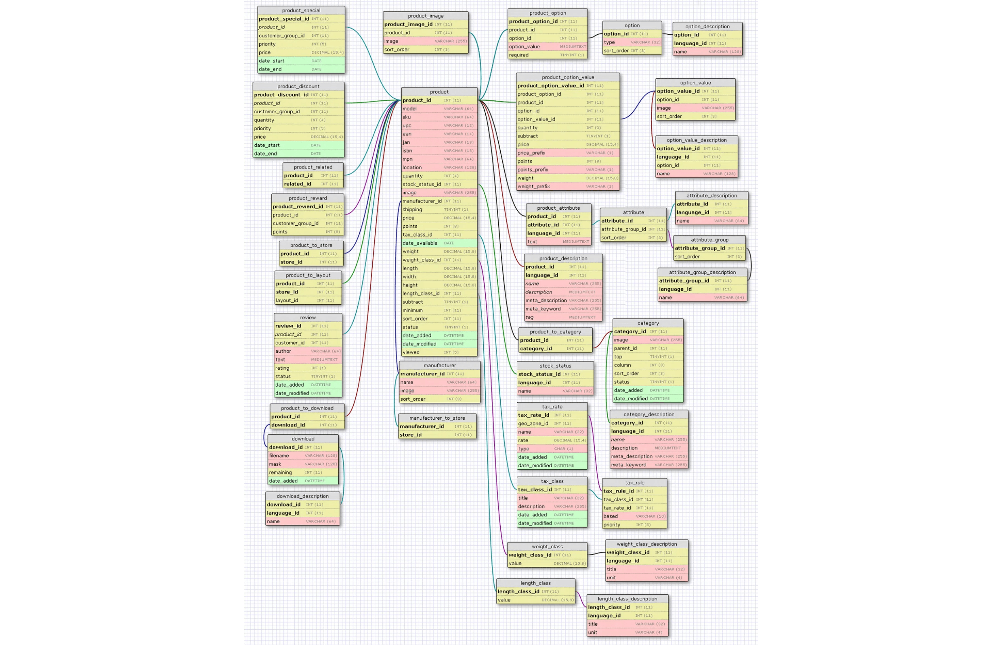
Transforming Raw Amazon Data into Actionable Insights
THE QUERY
"Top 5 products by sales volume"
A simple natural-language request—no table names or joins required.
THE ACTION
Automated Schema Mapping
AI detects relevant tables and join keys and builds the SQL automatically.
THE RESULT
Instant Visualization
Structured results are returned, ready for analysis and visualization.

Slide 10
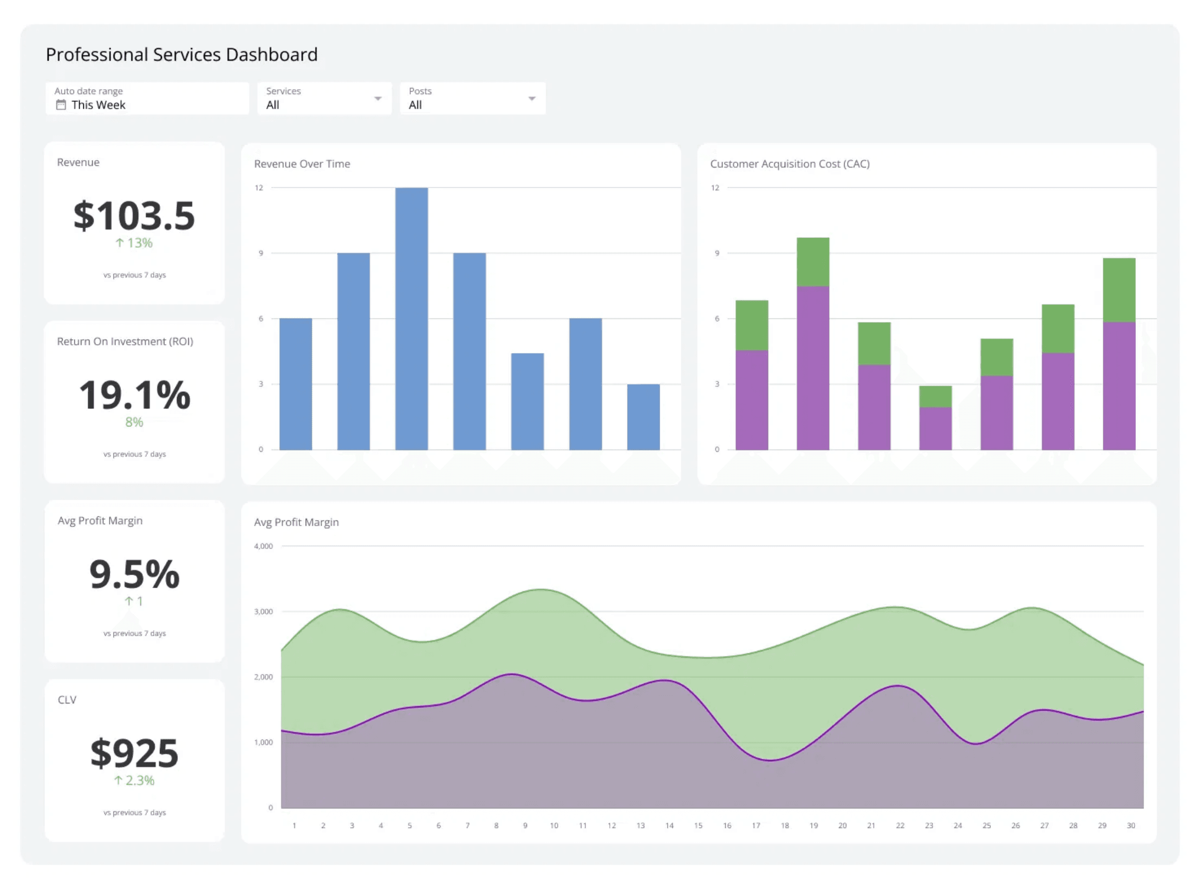
Optimized for Speed and Future Growth
Efficient Schema Caching
Reduces overhead for repeated queries by caching database metadata, ensuring near-instant response times for frequent users.
Flexible Model Support
Support for various Ollama models allows for scaling based on hardware capabilities, from lightweight to high-performance LLMs.
Modular Architecture
Modular code structure enables easy integration with other database types like PostgreSQL and MySQL for enterprise-wide deployment.

Slide 11
Continuous Evolution of
the AI Data Analyst
Phase 01
Data Visualization Integration
Native integration of Plotly and Altair libraries to automatically generate interactive charts and dashboards from query results.
Phase 02
Multi-turn Conversations
Support for contextual dialogue, allowing users to refine and drill down into data through natural, multi-step conversations.
Phase 03
Enhanced Error Handling
Advanced natural language explanations for query failures and automated suggestions for query refinement based on schema constraints.
Phase 04
Hybrid Cloud Expansion
Expansion to support hybrid deployment options, integrating with cloud-based LLM providers while maintaining local data security.

Slide 12
The Future of Data
Interaction is Natural
Democratization
Efficiency
Security
AI Data Analyst 2.0 empowers every user to access insights without needing technical SQL expertise.
Reduces the technical burden on data teams, allowing them to focus on high-value strategic initiatives.
A secure, private, and local solution designed to meet the rigorous demands of modern data challenges.
Questions & Answers

